Slide 1

Towards an Empirical Model to Identify When Bugs are Introduced
Thesis Defense Presentation
Gema Rodríguez Pérez
November 21, 2018
Universidad
Rey Juan Carlos

Slide 2
Overview
Background
Systematic Literature Review
Model to Identify Changes that Introduced Bugs
Empirical Evaluation of the Model
Findings
Implications and Recommendations

Slide 3
Overview
Background
Systematic Literature Review
Model to Identify Changes that Introduced Bugs
Empirical Evaluation of the Model
Findings
Implications and Recommendations

Slide 4
Understanding the problem
Importance of Bugs
Bug introduction
The impact
From 1 to 25 bugs for every 1000 lines inserted.
Software bugs costs almost $60 billions to the US.
It is focuses on identifying which changes introduced bugs.
In ESEM, it is based on the study of previous bugs.
Measuring developer performance.
Measure bug residency time.
Find bug-prone change patterns.

Slide 5
The Current Assumption:
“A given bug was introduced by the lines of code that were modified to fix it”

Slide 6
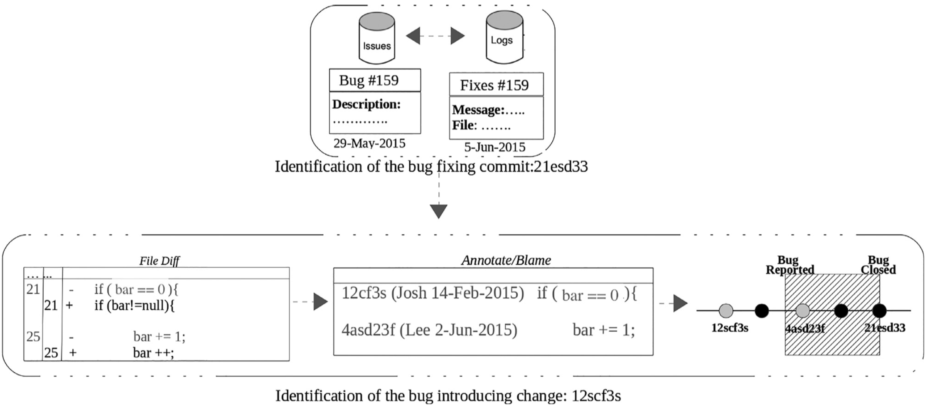

The SZZ Algorithm :

Slide 7
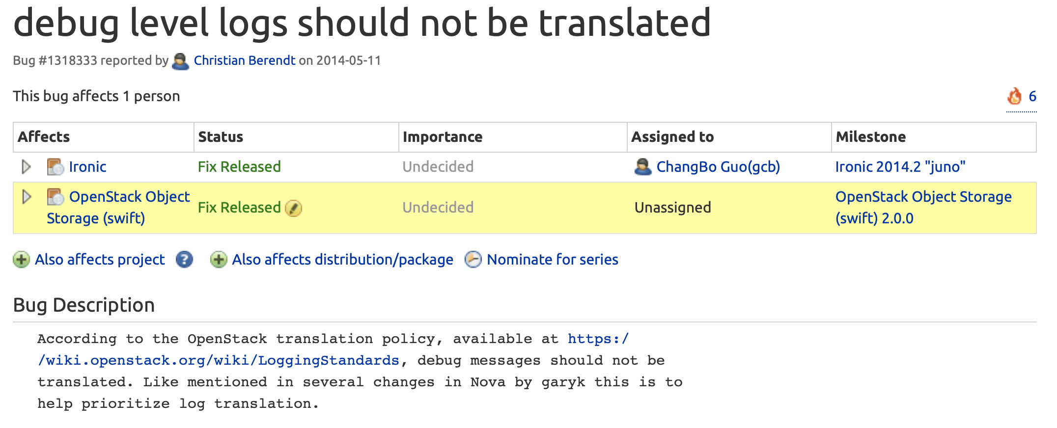
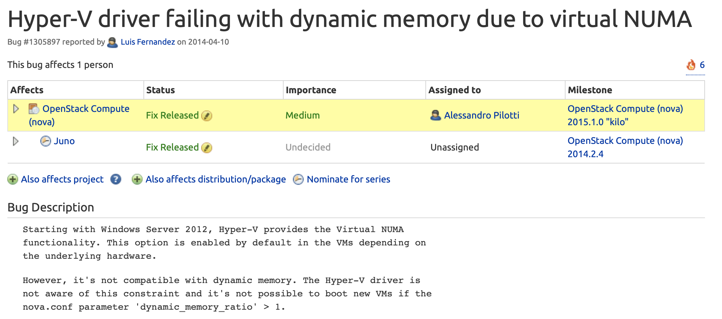
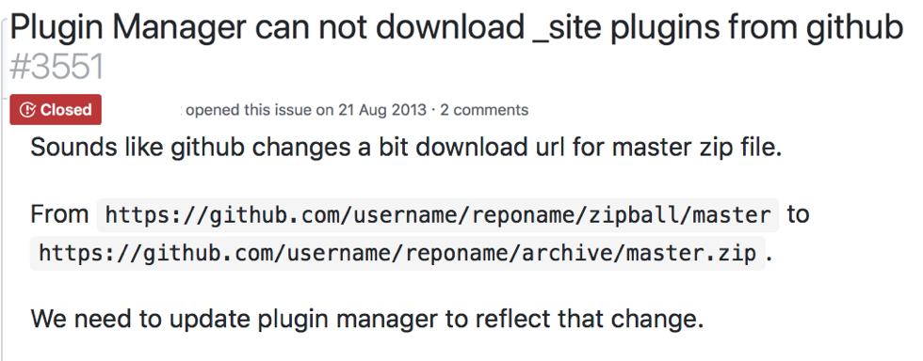
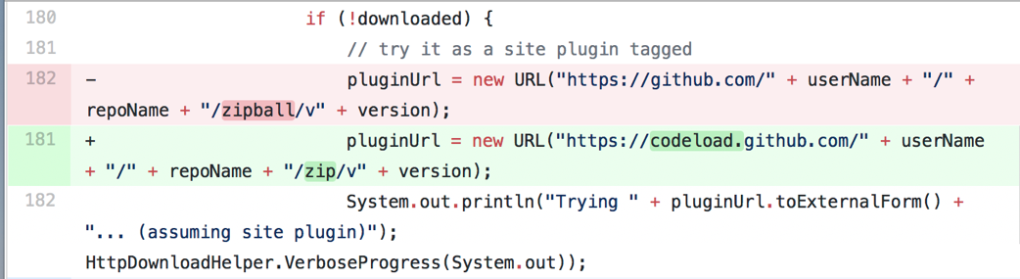
Is the assumption fulfilled in these scenarios?

Slide 8
Statement I:
“The fact of introducing a bug depends on the definition of bug, and the future work should verify whether the introduction of bug meets a given definition of bug” [Kim et al., 2006]

Slide 9
Statement II:
“It is necessary to develop new theories and mathematical models to increase understanding of software evolution, and to invest in research that tries to bridge the gap between the what of software evolution and the how of software evolution” [Mens et al., 2005]

Slide 10
Thesis’ Aim :
To develop a theory that:
1) defines what is a bug and,
2) how to identify when this bug was inserted
in a software product.

Slide 11
Thesis’ Contributions :
A SLR on the use of the SZZ algorithm.
A quantification of the SZZ algorithm.
A theoretical model for identifying bugs-introducing changes.
An empirical study to validate the theoretical model.

Slide 12
Overview
Background
Systematic Literature Review
Model to Identify Changes that Introduced Bugs
Empirical Evaluation of the Model
Findings
Implications and Recommendations

Slide 13
Reproducibility and Credibility in Empirical Software Engineering:
A case study based on a systematic literature review of the use of the SZZ algorithm:
What is the impact of the SZZ algorithm in academia?
Are studies that use the SZZ reproducible?
Do the publication mention the limitations of SZZ?

Slide 14
Inclusion Criteria :
All published studies written in English that cite either:
The original SZZ publication: “When do changes induce fixes?”, or
one of the two publications with improved versions:
“Automatic Identification of Bug-Introducing Changes”,
“SZZ Revisited: Verifying When Changes Induce Fixes” .

Slide 15
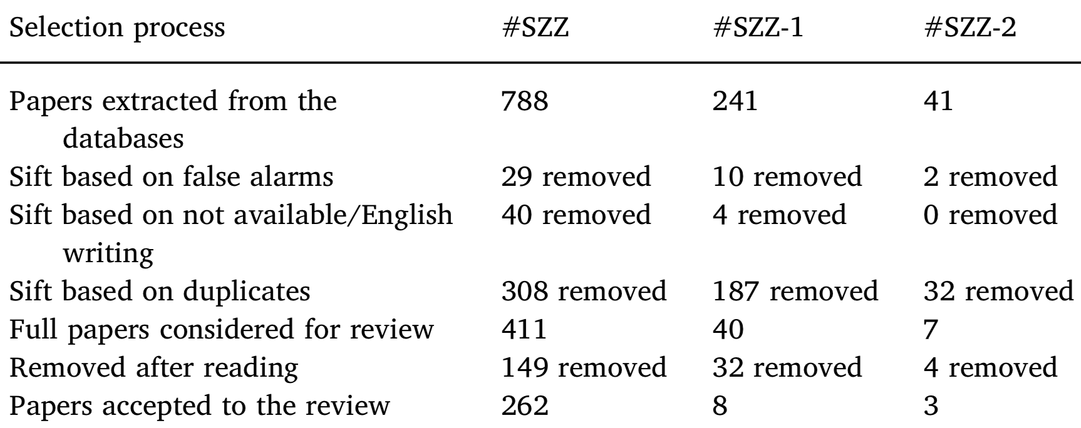
Exclusion Criteria :
149
187

Slide 16
Extracting Data from Papers:
Purpose and outcome of the study
Venue and class of publication
Whether it has a replication package
Whether it has a detailed description of the methods and data used
Whether the limitations of the algorithm are mentioned
Whether the authors use the improved versions of the SZZ algorithm.

Slide 17
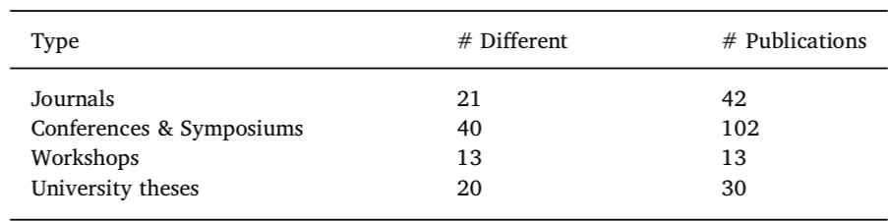
How is the impact of the SZZ algorithm?
High diversity

Slide 18
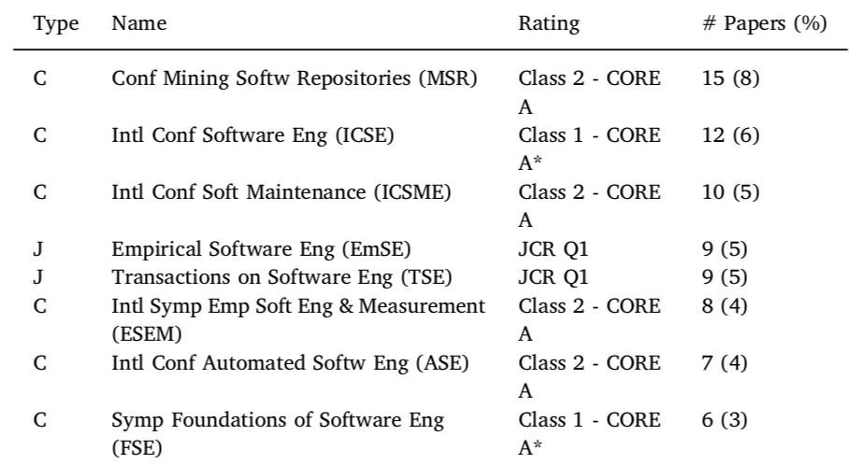
How is the impact of the SZZ algorithm?
High maturity

Slide 19
How is the impact of the SZZ algorithm?
High impact
Purpose
Outcome
Bug Prediction
Bug Proneness
Bug Detection
Bug Localization
Approach / Tools
Empirical Study
Replications
Metrics
DataSets

Slide 20
Are studies that use the SZZ reproducible?
 | Package Only | Environment Only | Both | None
YES | 19 | 72 | 24 | 72
NO | 168 | 96 | 163 | 115

Slide 21
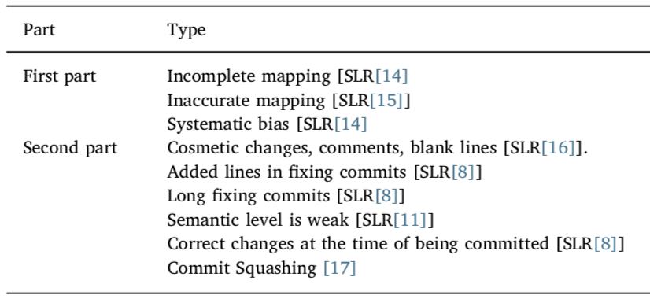

Do the publication mention the limitations of SZZ?

Slide 22
Do the publication mention the limitations of SZZ?
 | NO-TTV | TTV-1st part only | TTV-2nd part only | Complete TTV
YES | 94 | 44 | 10 | 39
NO | 93 | 143 | 177 | 148
TTV = Threats to Validity

Slide 23
Drawbacks
Functional
Many possible BICs
Only new additions
Multiple modifications of a line
Weak semantic level
Dormant bugs
Conceptual
Changing environment
Compatibility problems

Slide 24
Overview
Background
Systematic Literature Review
Model to Identify Changes that Introduced Bugs
Empirical Evaluation of the Model
Findings
Implications and Recommendations

Slide 25
Definitions: BFC, PC, DC, AC.
AC
PC
DC
PC
BFC
V2
V4
V6
Bug Fixing Commit
V2
V4
V6
Previous Commit
Descendant Commit
Previous Commit

Slide 26
Definitions : Test Signaling a Bug (TSB)
TSB is a hypothetical test that could be run on any snapshot.
TSB is a perfect test with 100% of coverage.
TSB returns TRUE No bug in the snapshot
TSB returns FALSE Bug in the snapshot

Slide 27


Definitions : Snapshot
V1
V2
V3
V4
V5
V6
V7
BFC
Dependencies, requirements, external artifacts …

Slide 28
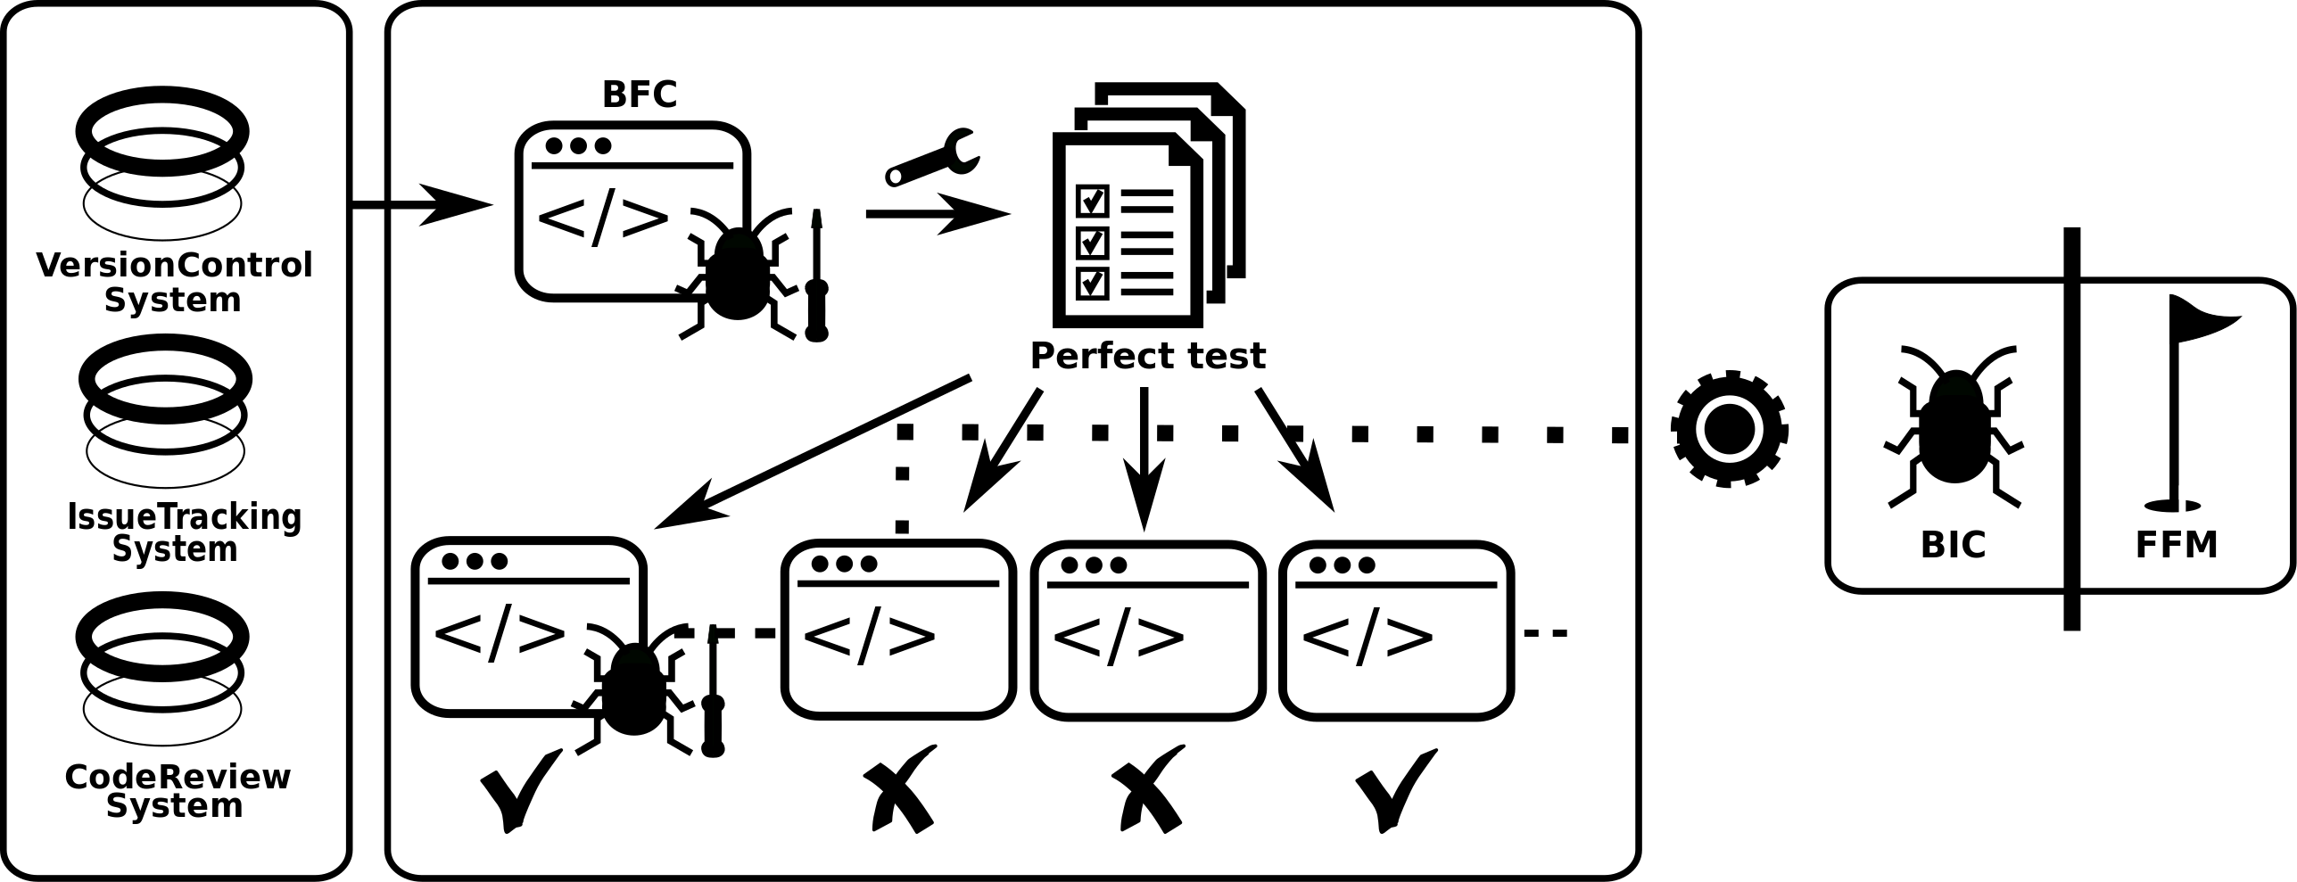
The Empirical Model

Slide 29




Test Signaling a Bug (TSB) and the BIS
VCS
ITS
CRS
BIS
BFS

Slide 30
Test Signaling a Bug not runnable
VCS
ITS
CRS
BIS
BFS

Slide 31
Test Signaling a Bug always fails
VCS
ITS
CRS
BFS

Slide 32
Overview
Background
Systematic Literature Review
Model to Identify Changes that Introduced Bugs
Empirical Evaluation of the Model
Findings
Implications and Recommendations

Slide 33
Case Studies
NOVA
ELASTICSEARCH
216 Companies
32470 Commits
1602 Contributors
4581836 LOCs
1930 Resolved bugs
39402 Commits
1032 Contributors
1187732 LOCs
4958 Resolved bugs

Slide 34
Research questions:
RQ1: What is the frequency for a BFC being caused by a BIC?
RQ1.1: Which reasons can explain that a BFC is not caused by a BIC?
RQ1.2: Could the location of a bug be modeled on the BIC and the FFM?
RQ2: What are the specifications that define the effectiveness of an algorithm used to locate the origin of a bug?
RQ2: Which reasons caused that a previous commit was not the BIC?

Slide 35
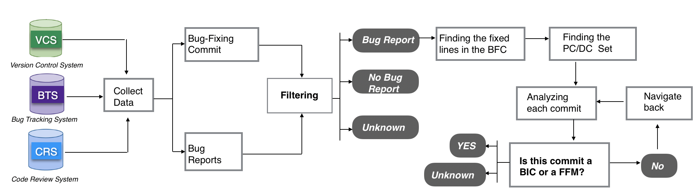
Methodology

Slide 36
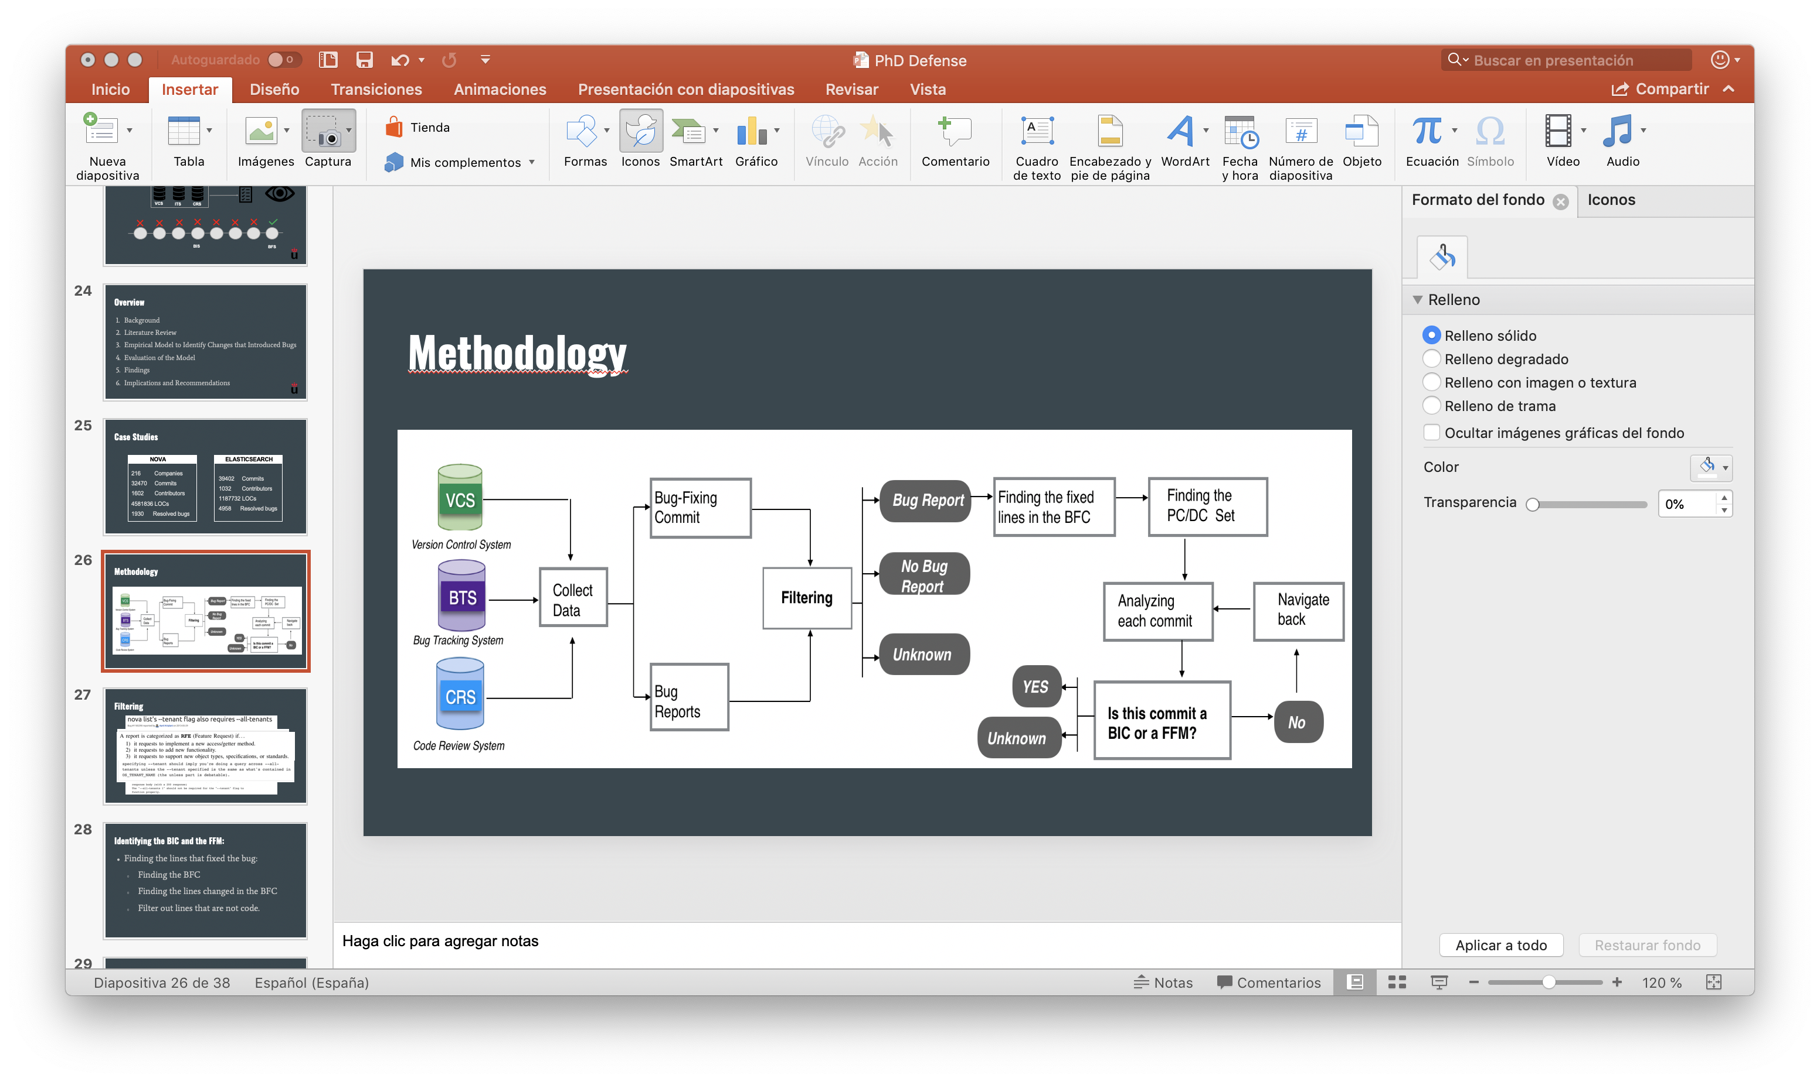
Methodology
GOLDEN SET
1) SZZ algorithm
2) SZZ-1 algorithm
3) SZZ-1E algorithm
Precision Recall F1- Score

Slide 37
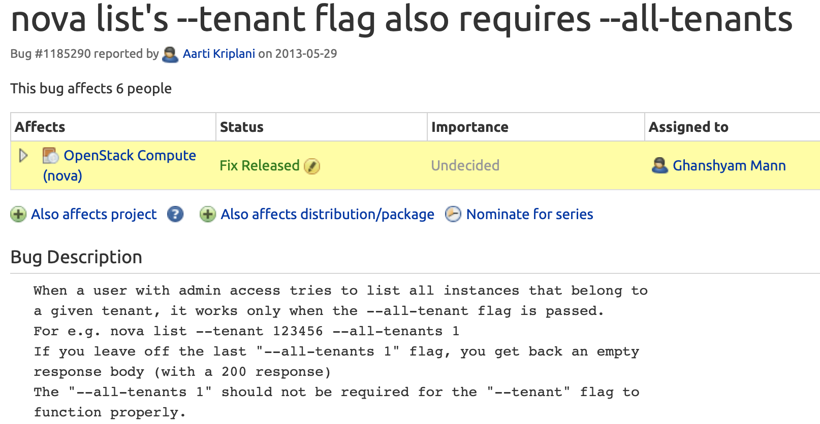
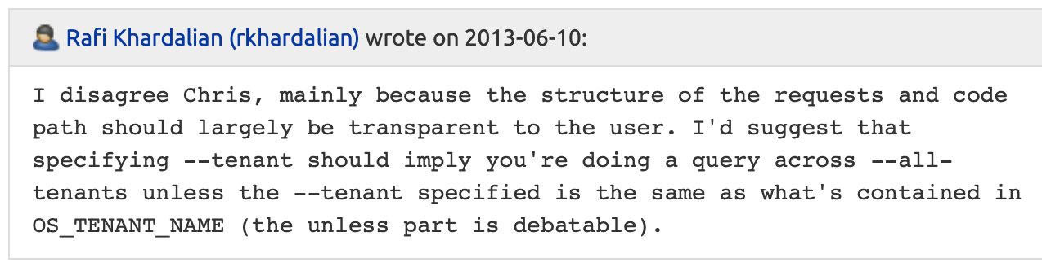
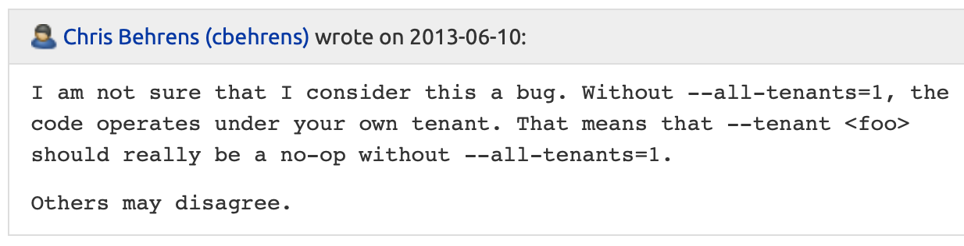
First Step: Filtering

Slide 38
Second Step: Identifying the BIC and the FFM
Finding the lines that fixed the bug:
Finding the BFC
Finding the lines changed in the BFC
Filter out lines that are not code.

Slide 39
Identifying the BIC and the FFM:
Determine the previous commit
Lines modified or removed Previous commits
Lines added Analize surroundings commits

Slide 40
Identifying the BIC and the FFM:
Analyze those previous commits to determine the FFM and BIC:
The commit inserted the bug BIC
The commit didn’t insert the bug FFM

Slide 41
Overview
Background
Systematic Literature Review
Model to Identify Changes that Introduced Bugs
Empirical Evaluation of the Model
Findings
Implications and Recommendations

Slide 42
Filtering Results
 | Bugs | Other Issues
Nova | 57 | 3
ElasticSearch | 59 | 1
Total | 116 | 4

Slide 43
RQ1 : What is the frequency for a BFC being caused by a BIC?
No BIC
BIC
Reasons of No BIC
57
59
21%
12
5
9%
 | Nova | ElasticSearch
Co-evolution Internal | 5 (42%) | 2 (40%)
Co-evolution External | 2 (17%) | 1 (20%)
Compatibility | 1 (8%) | 0 (0%)
Bug in External API | 4 (33%) | 2 (40%)
35
545
54
91%
45
79%
22
Nova
ElasticSearch

Slide 44
RQ2: What are the specifications that define the effectiveness of an algorithm used to locate the origin of a bug?
 | Precision | Recall | F1-Score
Nova SZZ | 0.32 | 0.60 | 0.42
Nova SZZ-1 | 0.35 | 0.58 | 0.44
Nova SZZ-1E | 0.64 | 0.60 | 0.66
ElasticSearch SZZ | 0.31 | 0.68 | 0.43
ElasticSearch SZZ-1 | 0.32 | 0.71 | 0.44
ElasticSearch SZZ-1E | 0.42 | 0.42 | 0.43

Slide 45
RQ2: Which reasons caused that a previous commit was not the BIC?
Variable renaming
Equivalent change
API changes
Obsolete code
Refactoring of the BFC

Slide 46
Overview
Background
Systematic Literature Review
Model to Identify Changes that Introduced Bugs
Empirical Evaluation of the Model
Findings
Implications and Recommendations

Slide 47
Implications and Recommendations
Most of the publications are not reporting the limitations of current algorithms to identify bug-introducing commits.
Studies should describe the algorithms and methods to mitigate their limitations.
Studies must be aware of the risk of every assumption used
The reproducibility of the studies is discovery limited.

Slide 48
Implications and Recommendations
Finding the origin of the bug is a complex task, but our model solves previous gaps.
A bug has to be contextualized to understand when and how it was inserted.
The correct identification of the origin of the bug can help to improve many areas in SE (bug detection, bug prediction, automatic fix generation …)

Slide 49
Thesis’ Publications :
Bugtracking: A tool to assist in the identification of bug reports. IFIP International Conference on Open Source Systems, 2016
How much time did it take to notify a Bug? Two case studies: ElasticSearch and Nova. IEEE/ACM 8th Workshop on Emerging Trends in Software Metrics (WETSoM), 2017
Reproducibility and Credibility in ESE: A Case Study based on a Systematic Literature Review of the use of the SZZ algorithm. Information and Software Technology, 2018.
What if a bug has a Different Origin? Making Sense of Bugs Without an Explicit Bug Introducing Change. 12th International Symposium on Empirical Software Engineering and Measurement, 2018

Slide 50
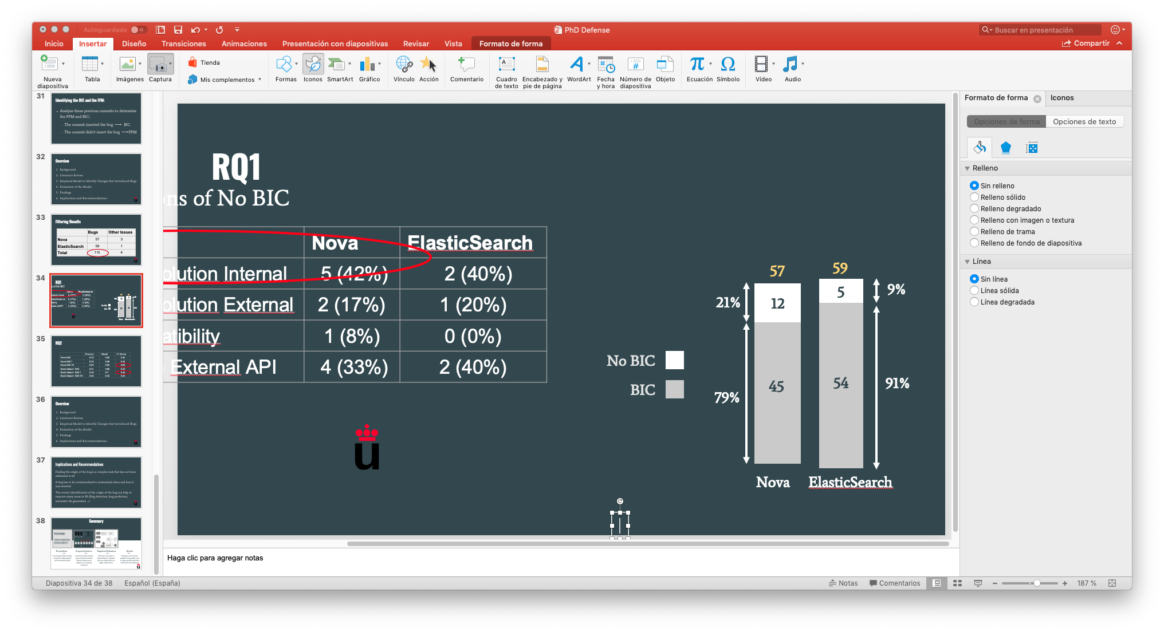
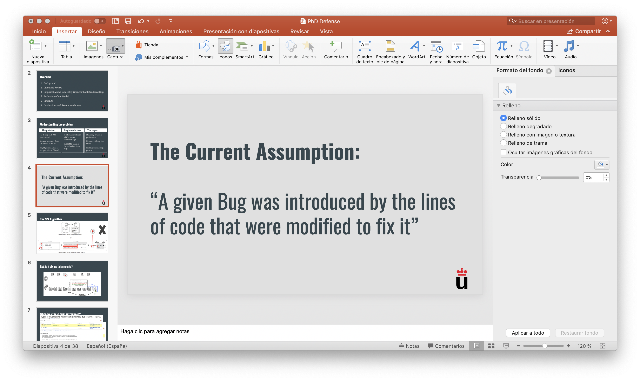
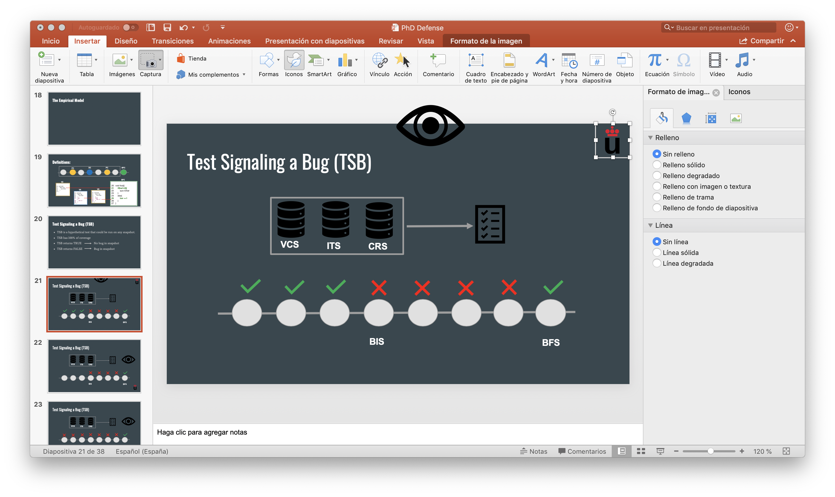
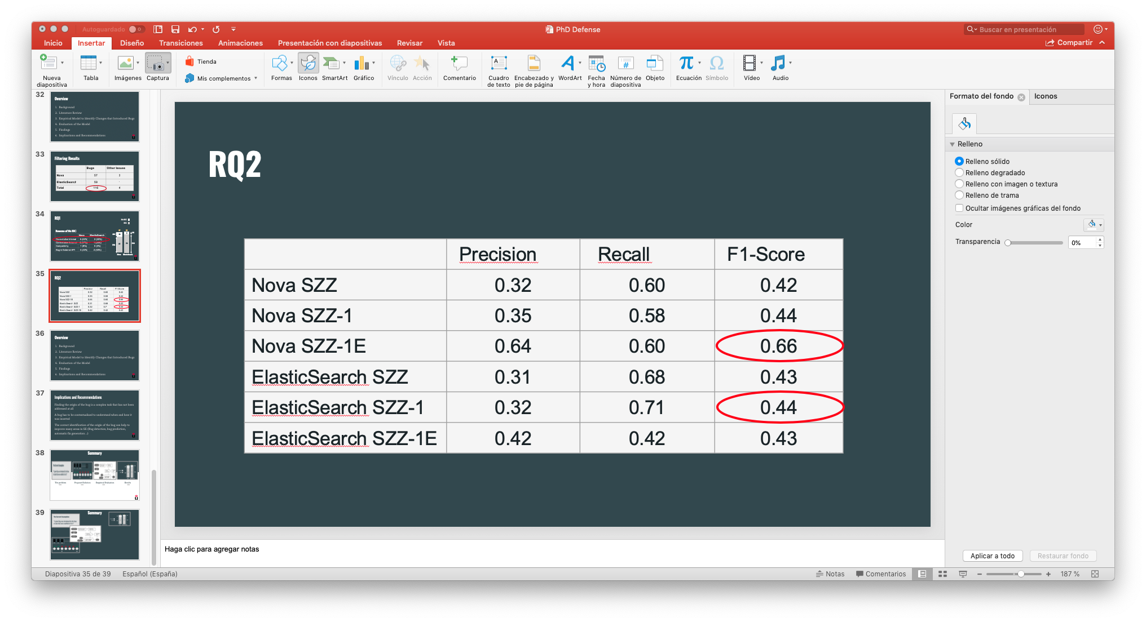
Summary
The problem
Findings
Solution
Findings
Evaluation

